Slide 1


WDMM 3314 Web and Multimedia Engineering SDEV 2301 Principles of Software Engineering
Dr. Nour Almadhoun Alserr
Fall Semester 2023
Notes:
Overcome Challenges

Slide 2




About Me
PhD in Computer Engineering @Bilkent University, Turkey (August 2020).
Summer School CGSI @UCLA, United States (July 2017).
MSc in Computer and Information Sciences @UTP, Malaysia, (December 2013).
BSc in Computer Engineering @IUG, Palestine (February 2010).
Research interest: data privacy, bioinformatics, and computational genomics.
Notes:
Processing, analyzing, and draw insights from qualitative and quantitative data.
Design research projects.
Building Inference attacks against genomic datasets.
Developing efficient and privacy-preserving methods for genomics and big data.

Slide 3



About Me
Senior Researcher @SAFARI research group- ETH Zurich, Switzerland (September 2020- June 2022).
Research Intern @Case Western Reserve University, United States (February 2020- August 2020).
Teaching Assistant @ETH Zurich @Bilkent University @UTP (2011-2022).
Research Assistant @Bilkent University @UTP (2011-2020).
Contact: nour.madhoun@gmail.com

Slide 4
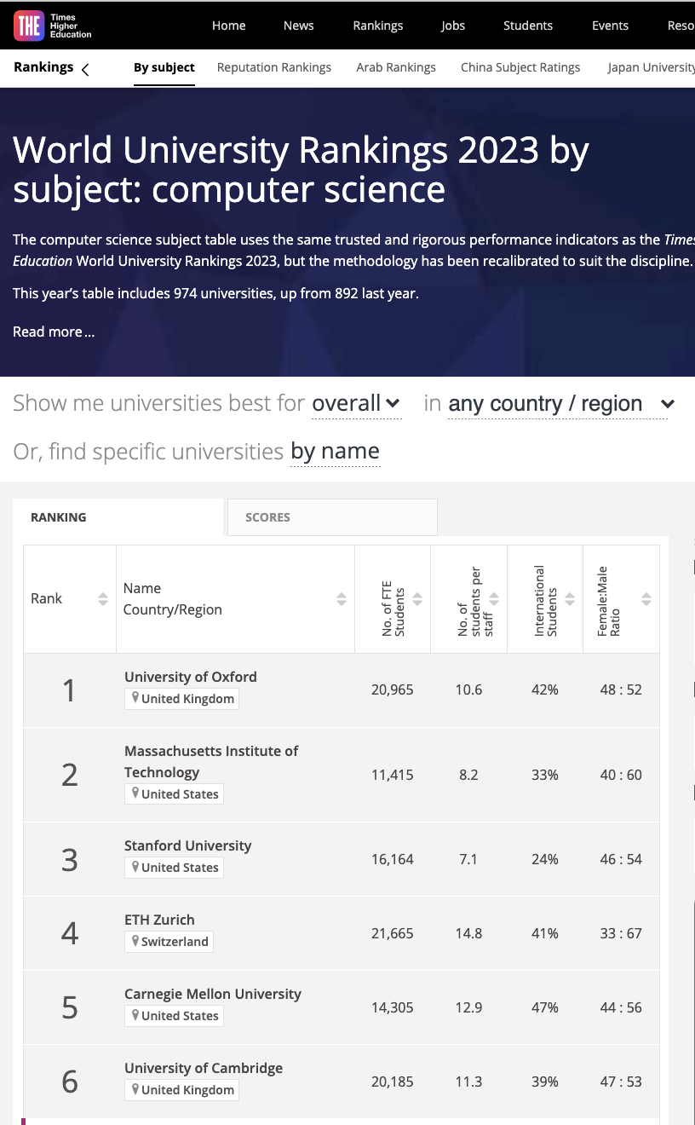
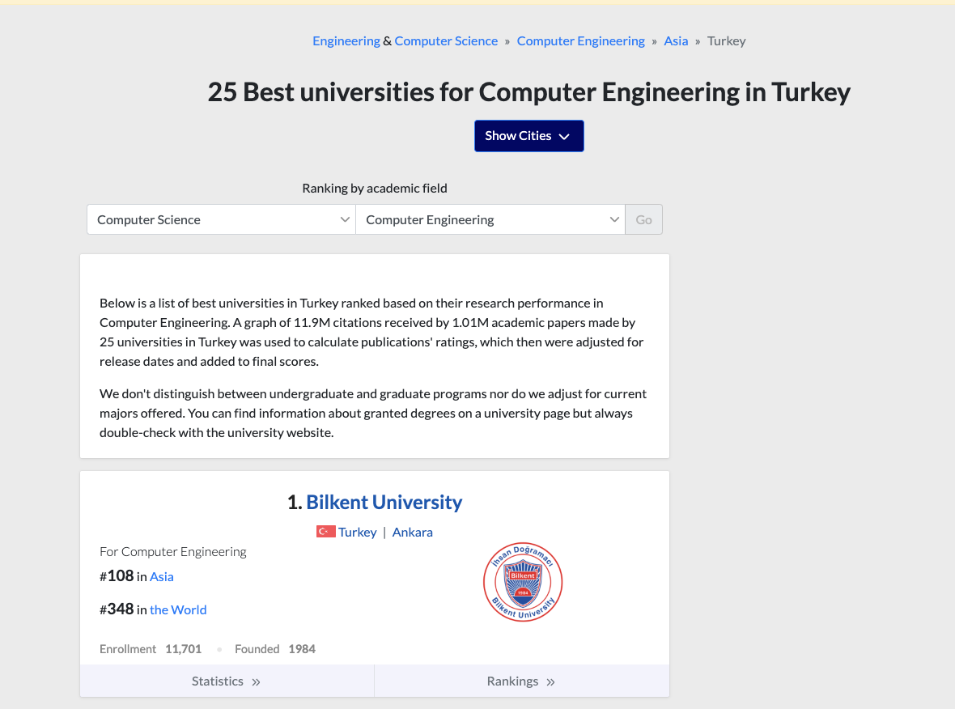
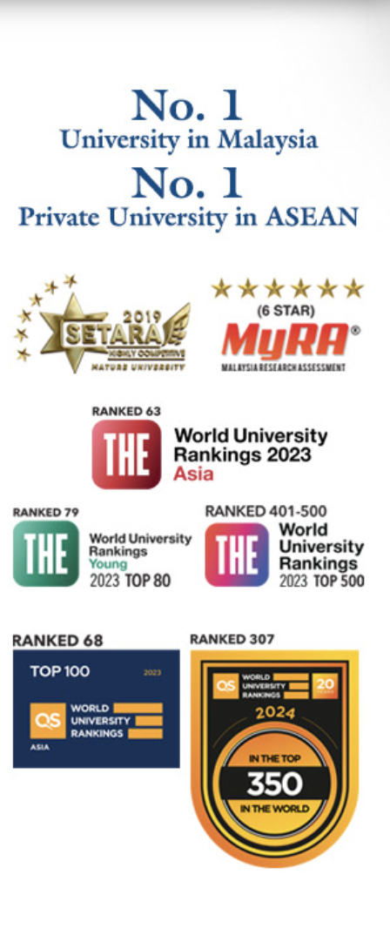

Top Universities
1 https://www.timeshighereducation.com/world-university-rankings/2023/subject-ranking/computer-science
2 https://edurank.org/cs/computer-engineering/tr/ 3 https://www.utp.edu.my/Pages/Home.aspx 4 https://www.iugaza.edu.ps/p29807/

Slide 5
Course Info
Lecture Times:
Section 201: Sat, Mon & Wed: 08:00-09:00 Room: L304
Section 201: Sat, Mon & Wed: 9:00-10:00 Room: I102
Section 202: Sat, Mon & Wed: 11:00-12:00 Room: L317
Office Hours: TBA (to be announced) .
Office Location: TBA.

Slide 6
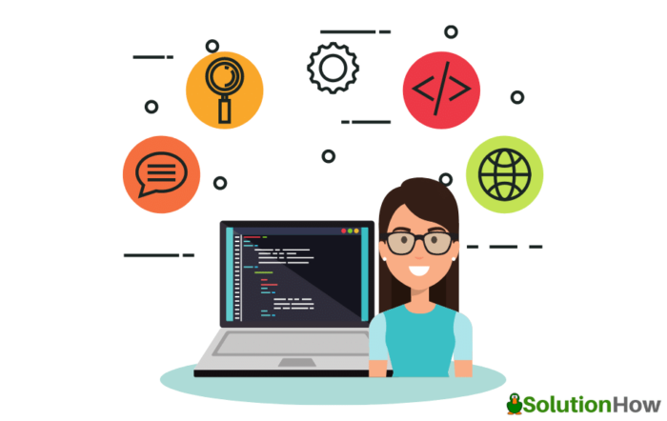


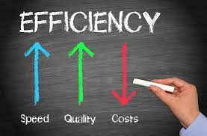
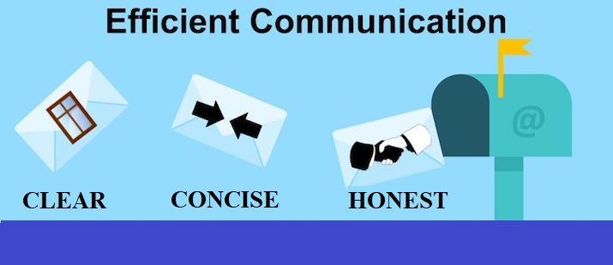
Software Engineers
Software Engineers apply Engineering Principles to software creation.
Notes:
By engineering principles we mean the ideas, rules, or concepts that need to be kept in mind when solving an engineering problem. However, there is no one specific list of engineering principles that can be written down or posted up on the web. That is because the concepts used to solve a problem will often be different depending on the type of problem encountered.
For communication to be effective, it must be clear, correct, complete, concise, and compassionate

Slide 7
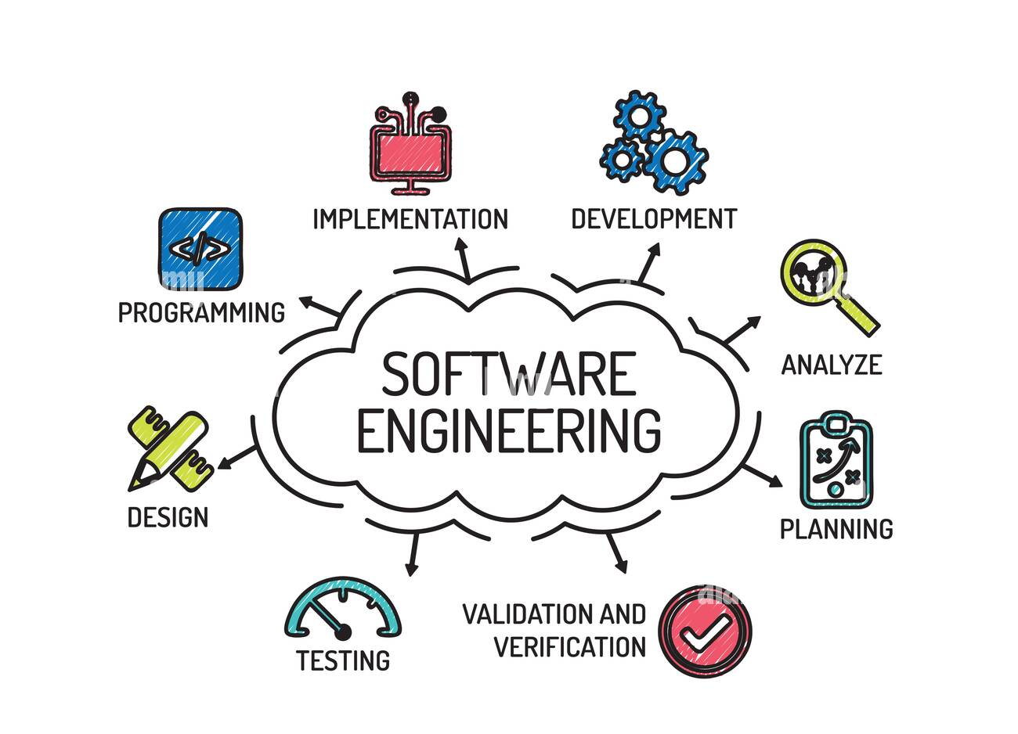
Software Engineering
Alamy stock photos
Notes:
Software engineers apply engineering principles to software creation. They oversee the entire process of designing, developing, testing, and maintenance of software. These professionals help with the software development process by connecting developers and clients as well as creating solutions that developers later turn into code.
Software engineers solve problems at a larger scale than software developers do. They oversee the entire software creation process while developers have specific tasks to fulfill.
Basically, Software engineering was introduced to address the issues of low-quality software projects. Here, the development of the software uses the well-defined scientific principal method and procedure

Slide 8
Need for Software Engineering
Handling Big Projects
Reduce complexity
Decrease time
Importance of Software Engineering
Effectiveness
Minimize software cost
Reliable Software
Notes:
Effectiveness is the extent to which someone or something is successful towards meeting the desired outcome.
Reliability is the degree of consistency of a measure. A test will be reliable when it gives the same repeated result under the same conditions.
It is the company’s responsibility to deliver software products on schedule and to address any defects/problems that may exist.

Slide 9
Course Description
This course covers the following topics:
Introduction to the concepts, methods, and current practices of software engineering and web engineering.
Software engineering process and process models.
Project management and planning.
Requirements engineering.
System modeling.
Detailed design and implementation issues.
Verification and validation.
Software application framework.
Documentation.
Notes:
Chapter 1: professional software engineering and defines some software engineering concepts, a brief discussion of ethical issues in software engineering, four case studies.
Slides: (Professional software development, Software engineering ethics, Case studies.)
Chapter 2: I introduce software process models, such as the waterfall model, and I discuss the basic activities that are part of these
processes.
Slides: (Software process models, Process activities, Coping with change, Process improvement)
Chapter 22: risk management and people management
Chapter 23: project planning, scheduling, and cost estimation.
Slides: (Reasons for Undertaking Software Projects, Management activities, Project planning, Project scheduling, Risk management)
Chapter 3 supplements this with a discussion of agile development methods for software engineering.
Slides: (Software Engineering Process Models, Waterfall, Prototyping, Incremental, Spiral, Rational Unified Process, Agile Methods)
Chapter 4 covers the critically important topic of requirements engineering, where the requirements for what a system should do are defined.
Slides: (Requirements and requirements document, Requirements engineering process)
Chapter 5 explains system modeling using the UML, where I focus on the use of use case diagrams, class diagrams, sequence diagrams and state diagrams
for modeling a software system.
Slides: (System Modelling Concepts, Unified Modelling Language (UML), Use Case Diagram, Sequence Diagram, Class Diagram, State chart Diagram, Package Diagram, Deployment Diagram)
Chapter 7 introduces object oriented design and the use of design patterns. I also introduce important implementation issues here—reuse, configuration management and host-target development and discuss open source development.
Slides: (Object-Oriented Design Using the UML, Design Patterns, Implementation Issues, Open Source Development )
Chapter 8 focuses on software testing from unit testing during system development to the testing of software releases.
Chapter 15 understand the concept of an application framework as a set of reusable objects and how frameworks can be used in application development.

Slide 10




Course Objectives
Upon the completion of this course, students should be able to :
Describe the concepts of software engineering and web engineering.
Understand the software process and the software process models.
Understand and apply the principles and techniques that appropriate for each stage of software production.
Demonstrate and communicate software engineering principles effectively through written reports and/or verbal presentations.
Practice how to work in a motivated, supportive, and well managed team environment.

Slide 11
Course Schedule
Week | Topic | Readings
1 | Introduction | Chapter 1
2,3 | Software Processes | Chapter 2
4,5 | Project Management & Planning | Chapter 22&23
6,7 | Software Process Models | Chapter 3
8,9 | Requirements Engineering | Chapter 4
10,11 | System Modeling (Unified Modeling Language (UML)) | Chapter 5
12 | Design and Implementation | Chapter 7
13 | Software Testing | Chapter 8
14 | Software Applications Frameworks | Chapter 15
15 | Review and Course Project Discussion
Notes:
Chapter 1: professional software engineering and defines some software engineering concepts, a brief discussion of ethical issues in software engineering, four case studies.
Slides: (Professional software development, Software engineering ethics, Case studies.)
Chapter 2: I introduce software process models, such as the waterfall model, and I discuss the basic activities that are part of these
processes.
Slides: (Software process models, Process activities, Coping with change, Process improvement)
Chapter 22: risk management and people management
Chapter 23: project planning, scheduling, and cost estimation.
Slides: (Reasons for Undertaking Software Projects, Management activities, Project planning, Project scheduling, Risk management)
Chapter 3 supplements this with a discussion of agile development methods for software engineering.
Slides: (Software Engineering Process Models, Waterfall, Prototyping, Incremental, Spiral, Rational Unified Process, Agile Methods)
Chapter 4 covers the critically important topic of requirements engineering, where the requirements for what a system should do are defined.
Slides: (Requirements and requirements document, Requirements engineering process)
Chapter 5 explains system modeling using the UML, where I focus on the use of use case diagrams, class diagrams, sequence diagrams and state diagrams
for modeling a software system.
Slides: (System Modelling Concepts, Unified Modelling Language (UML), Use Case Diagram, Sequence Diagram, Class Diagram, State chart Diagram, Package Diagram, Deployment Diagram)
Chapter 7 introduces object oriented design and the use of design patterns. I also introduce important implementation issues here—reuse, configuration management and host-target development and discuss open source development.
Slides: (Object-Oriented Design Using the UML, Design Patterns, Implementation Issues, Open Source Development )
Chapter 8 focuses on software testing from unit testing during system development to the testing of software releases.
Chapter 15 understand the concept of an application framework as a set of reusable objects and how frameworks can be used in application development.

Slide 12
Course Teaching Method
The class will be taught as a combination of:
Lectures.
Software presentations.
Group discussion.
Exercises and discussion of real world cases.
Online learning using Moodle.
A project describes the development of a real-world software application.

Slide 13

Main Textbook
Ian Somerville, “Software Engineering”, 10th edition, Pearson, 2016.

Slide 14
Course requirements
Include attendance of all lecturers, demonstrations and review of assignments given in previous classes. Excessive absences that exceed 25% of the lectures will be reported to the college administration.
The students must learn and use the following software tools carefully: MS Project, Visual Paradigm, Visual Studio Code, NetBeans and must have good experience with at least one of the following programming languages: Java, JavaScript, PHP and/or Python.

Slide 15
Grading
Criterion | Percentage
Attendance, Assignments and Quizzes | 20%
Project | 20%
Midterm | 20%
Final exam | 40%
Total | 100%

Slide 16

Assignments and Quizzes
The assignments will be provided throughout the course.
An assignment at the end of each chapter.
Hand written answers are required.
Several pop quizzes throughout the course.

Slide 17

Do you have
any QUESTION?
Notes:
Do you have any Questions?

